Slide 1

Human-Computer Interaction (HCI)
Mario Čagalj
University of Split
10.10.2012.

Slide 2
Human-Computer Interaction: Introduction
Based on slides by Saul Greenberg, Russell Beale, Tolga Can…

Slide 3
HCI
The study of how people interact with computers
  And to what extent computers are developed for successful interaction with human beings
Consists of three parts
  The user
  The computer
  The way they work togheter
Why HCI?

Slide 4
http://www.youtube.com/watch?v=kKT_09pARN4

Slide 5
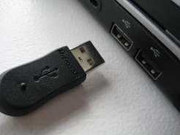
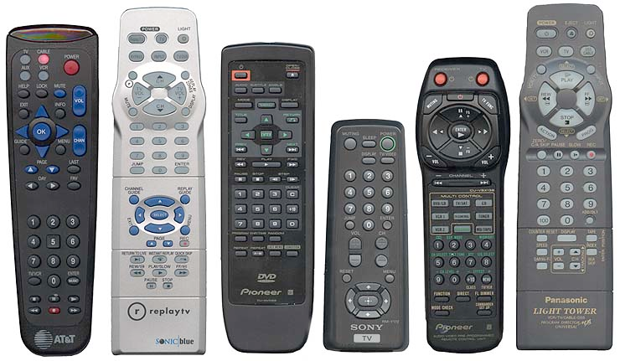
Numerous badly designed things
http://www.baddesigns.com

Slide 6
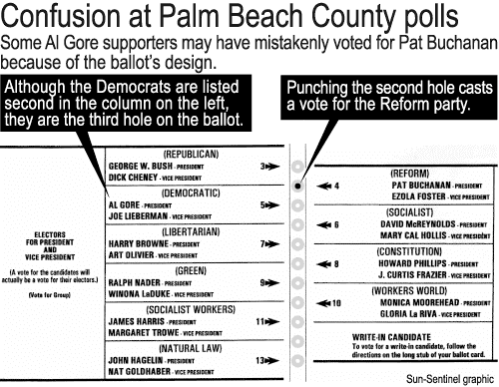
Does it matter?
If the things are badly designed?
  Well, you can crash your car and get injured
  You can go out of business
  Lose elections (US 2000)
  Get angry and make
  mistakes – then the
  thing will take longer
  than usual

Slide 7
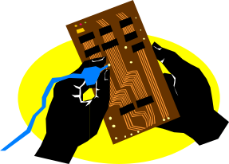
Moor’s law
Computer
abilities
transistors
speed
discs
cost
1950
1990
2030

Slide 8
Psychology
human
abilities
2000BC
1950
1990
2030

Slide 9
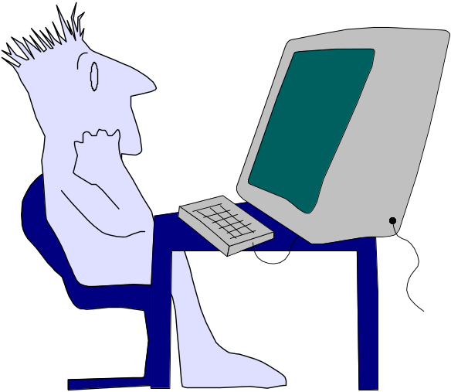
Where is the bottleneck?
system
performance

Slide 10
Human Computer Interaction
A discipline concerned with the
of interactive computing systems for human use
design
implementation
evaluation

Slide 11
An interface design process and usability engineering
Articulate:
who users are
their key tasks
Brainstorm designs
Refined designs
Completed designs
Goals:
Task centered system design
Participatory design
User-centered design
Psychology of everyday
things
User involvement
Representation & metaphors
Graphical screen
design
Interface guidelines
Style
guides
Participatory interaction
Task scenario walk-
through
Evaluate
Usability testing
Heuristic evaluation
Field testing
Methods:
low fidelity prototyping methods
high fidelity prototyping methods
Products:
User and task descriptions
Throw-away paper prototypes
Testable prototypes
Alpha/beta systems or complete specification
Notes:
This diagram captures the major topics in the course and how they fit together as a process defining interface design and usability engineering.
The process goes left to right, where each major block showing the typical things that interface designers have to do. Each block indicates the goals to be accomplished, the methods (or tricks of the trade) that help accomplish those goals, and the products.
In practice, not every step or method is followed. Rather, the interface developer will choose methods appropriate to the time and budget of the project.

Slide 12
Why an interface design process?
63% of large software projects go over cost
  Managers gave four usability-related reasons
    Users requested changes
    Overlooked tasks
    Users did not understand their own requirements
    Insufficient user-developer communication and understanding
Usability engineering is software engineering
  Pay a little now, or pay a lot later!
  Far too easy to jump into detailed design that is
    Founded on incorrect requirements
    Has inappropriate dialogue flow
    Is not easily used
    Is never tested until it is too late

Slide 13
Foundations for designing interfaces
Understanding users and their tasks
  Task-centered system design
    How to develop task examples
    How to evaluate designs through a task-centered walk-through
Designing with the user
  User-centered design and prototyping
    Methods for designing with the user
    Low and medium fidelity prototyping
  Evaluating interfaces with users
    The role of evaluation in interface design
    How to observe people using systems to detect interface problems
Notes:
Task-centered system design is a technique that helps developers design and evaluate interfaces based on users' real-world tasks. As part of design, it becomes a user-centered requirements analysis (with the requirements being the tasks that need to be satisfied). As part of evaluation, the evaluator can do a walk-through of the prototype, using the tasks to generate a step by step scenario of what a user would have to do with the system. Each step in the walkthrough asks the questions: is it believable that a person would do this; and does the person have the knowledge to do it? If not, then a bug has been found.
http://uow.ico5.janison.com/ed/subjects/EDGI957/resources/HCIComplete.pdf :
The flip side of the "it's obvious" coin is that most actions used to accomplish tasks with an
interface are quite obvious to people who know them, including, of course, the software
designer. But the actions are often not obvious to the first-time user. For example, imagine a
first-time user of a multiuser computer who has been shown how to login to the system, has
done some work, and is now finished with the computer for the day. Experienced computer
users will find it obvious that a logout command is needed. But it may not occur to first-time
users that a special action is required to end the session. People don't "log out" of typewriters
or televisions or video games, so why should they log out of computers? Even users who
suspect that something is required won't be likely to know that typing the word "logout" or
"exit" might do the job.
Learning to predict problems like these by taking the user's point of view is a skill that
requires practice, and that practice is a fundamental goal of the exercises.
REF:
http://hcibib.org/tcuid/chap-1.html (The Task-Centered Design Process)
http://uow.ico5.janison.com/ed/subjects/EDGI957/resources/HCIComplete.pdf
------------------------
User-centered system design and participatory design both argue that users should be an integral part of the design process. One important means for involving users is through prototypes. Through prototypes, users can react to ideas and even take part in building and modifying them.
Prototyping methods move from low to medium fidelity: paper sketches, storyboards, Pictive, scripted simulations and so on, each getting slightly more sophisticated. Early versions of prototypes should be very low cost (e.g., paper and pencil, postit notes, etc), and its purpose should be to garner high-level reaction and input from the user. As the design progresses, prototypes should become more refined and the user's input should reflect smaller, but still important, design and usability decisions.
System Centered Design
What can I easily build on this platform?
What can I create from the available tools?
What do I as a programmer find interesting?
User Centered System Design
Design is based upon a user’s
– abilities and real needs
– context
– work
– tasks
– need for usable and useful product
Golden rule of interface design: Know The User
Participatory Design
Problem
– intuitions wrong
– interviews etc not precise
– designer cannot know the user sufficiently well to answer all
issues that come up during the design
Solution
– designers should have access to representative users
– END users, not their managers or union reps!
----------------------
Evaluating interfaces with users' involvement form the basis for usability studies. A good evaluation process means that designers will catch major problems (and successes!) early on, with lesser problems being ironed out as the interface is being refined. Fortunately, there are many low cost evaluation methods for discovering usability problems. Most of these are based on observing people as they use your system to perform particular tasks.

Slide 14
Foundations for designing interfaces
Designing visual interfaces
  Design of everyday things
    What makes visual design work?
  Beyond screen design
    Representations and metaphors
  Graphical screen design
    The placement of interface components on a screen
Principles for design
  Design principles, guidelines, and usability heuristics
    Using guidelines to design and discover usability problems
Notes:
While computer design has its own idiosyncrasies, we can learn a tremendous amount by looking at the design of everyday things. We start with bad design, which make us realize that the problems and errors people face when dealing with even simple technology are usually a result of design failure. We then move to understanding visual design principles that help us analyze bad design and create good designs.
----------------------------
Creating good interfaces requires designers to think really hard about how they want to visualize the essence of the interface. In essence the interface becomes a visual language which in turn is created from several concepts: the basic visual representation, how data is visualized (information visualization and visual variables) , choosing appropriate metaphors, and providing good interaction techniques such as direct manipulation and dynamic queries.
----------------------------
Guidelines to design have a long tradition in interface design. There are literally thousands now available, in many forms and variations. These tend to fall in the categories of: motherhoods (or general guidelines); specific guidelines that say exactly what should be done in a given situation; style guides that are particular to a look and feel; and widget-level guidelines that are embedded within the actual toolkit.
Most of this module develops general design guidelines, detailing what they mean and how the interface should cater to them. In particular, I show how guidelines can be used as a low-cost evaluation technique via heuristic evaluation. Through this method, several evaluators inspect the interface for compliance to the guidelines. While heuristic evaluation does not require users' involvement, it still manages to capture many major usability problems.

Slide 15
Goals of the course
At the end of this course, you will:
  Know what is meant by good design (guidelines and models that can be applied to interface design)
  Know and have applied a variety of methods for involving the user in the design process
  Know and have applied methods to evaluate interface quality

Slide 16
In other words…
Consciousness raising
  Make you aware of these issues
Design critic
  Question bad design

Slide 17
Class project
Design and evaluate an interface
  Part 1 - Team formation & topic choice, understand and formulate the problem, roadmap
  Part 2 - Design alternatives, prototype & evaluation plan, evaluation, user studies

Slide 18
Class project: details
Part 1
  Identify team (2-3) & topic
  Define the problem
  Describe tasks, users, environment, social context

Slide 19
Class project: details
Part 2
  Discuss design alternatives
  Storyboards, mock-ups/prototypes for multiple different designs
  Explain decisions
  Semi-working interface functionality
  Plan for conducting evaluation
  Evaluation: Conduct evaluation with example users (2-3 users), characterize what’s working and what’s not

Slide 20
Project Reports & Presentations
Last weeks of classes and lab
  20 minute presentation of your project

